Slide 1

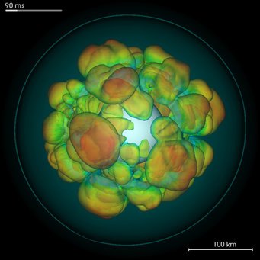


Using Light Curves from Core Collapse Supernovae to Better Search for Gravitational Waves
By Jake Markovsky and Katelynn Wall
Mentor : Michele Zanolin
https://www.mpa-garching.mpg.de/84411/Core-collapse-supernovae

Slide 2
False Alarm Probability of a Gravitational Wave Search
FP = τ • FR
FP= False Alarm Probability
FR= False Alarm Rate
τ = Time duration of data being examined for Gravitational Waves (GW)

Slide 3
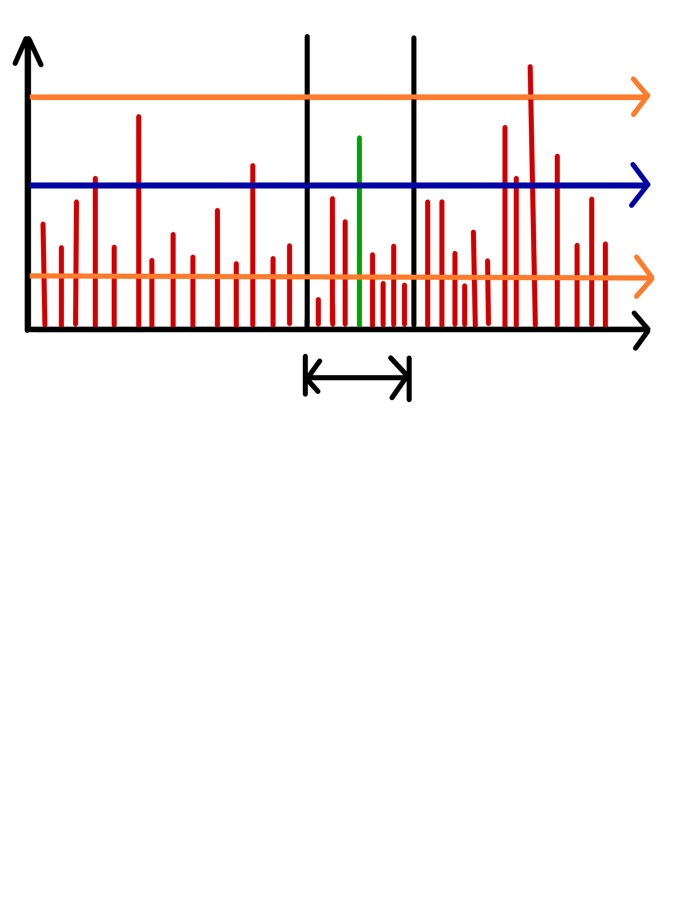
False Alarm Probability of a Gravitational Wave Search
Problem: Want smaller τ to make the detection easier and/or with larger statistical confidence.
Solution: Use electromagnetic observation of Core Collapse Supernovae (CCSN) to decrease τ.
FAR too high
Energy
Red Line - false detection
Green line - energy from GW candidate
FAR too low
time
On Source Window

Slide 4
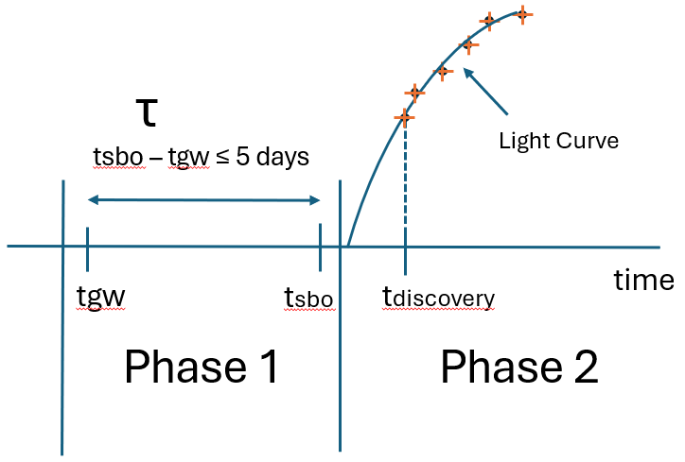
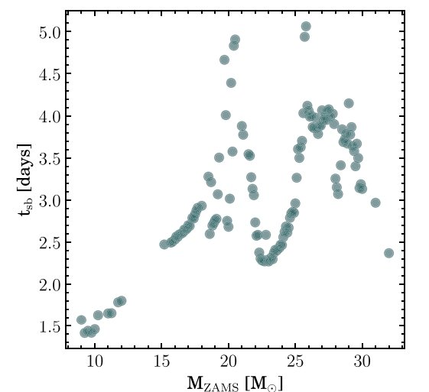
How to Find On Source Window
From the light curve of a CCSN we can find the On Source Window
Mass of the progenitor
tsbo - tgw
Couch, S. M., Warren, M. L., & O’Connor, E. P. 2020,
ApJ, 890, 127
Notes:
Explain the why of the light curve and what its used for

Slide 5
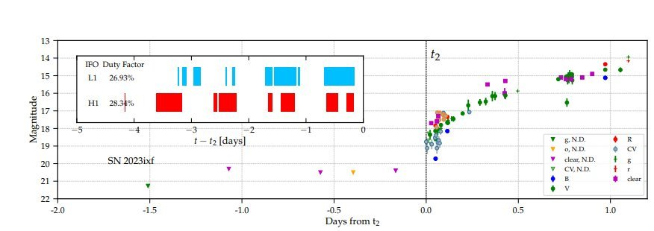
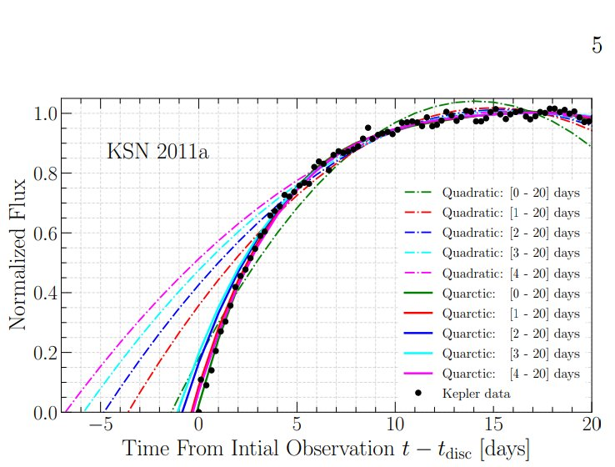
Modeling the Light Curves
Ligo detection alongside light curve of SN2023ixf
2023ixf is a rare example of a fully recorded light curve
Quartic fit works better

Slide 6
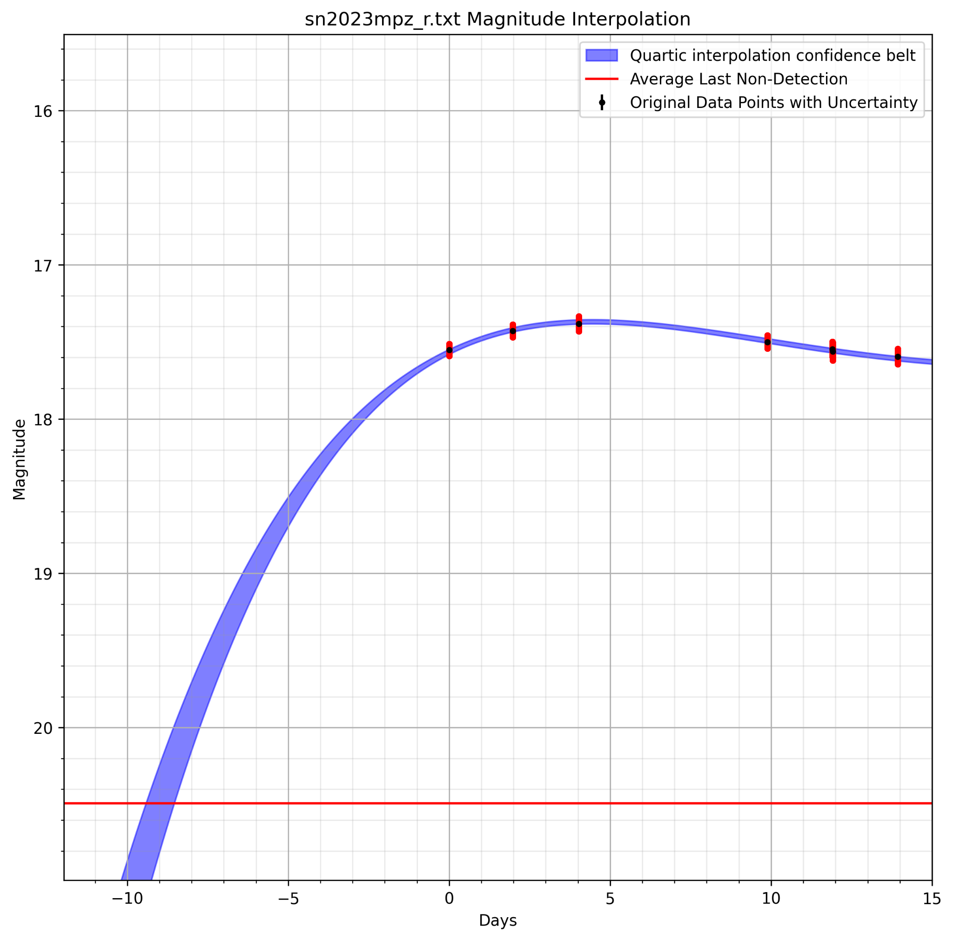
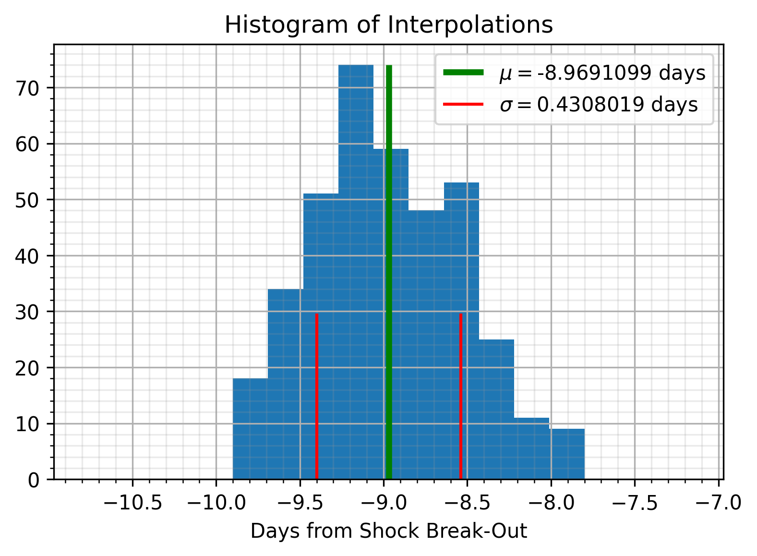

Interpolation Process
SN2023mpz
The posterior distribution of the estimated tsbo

Slide 7
But quartic fits aren’t always reliable…

Slide 8
A More Physics Based Approach
Purpose
Obtain properties of the progenitor star
Model the light curve with a physics-based code using equations proposed in the paper Sapir, Waxman et al (2017)
Compare performance of physics-based to quartic-based light curve models

Slide 9
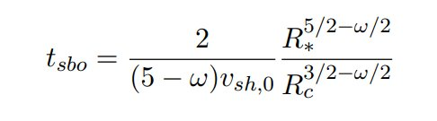

Equations for Physics Based Approach
R* = Stellar Radius
R_{c} = Core Radius
V_{sh}= Shockwave Velocity
ω = Density profile
v = velocity of shockwave
r = radius (where the shockwave is at)
m = mass enclosed
p = Radiation Pressure
1.)
2.)
3.)
e = Energy Density
ρ = Density of Stellar Envelope
j = Energy Flux
v = V_{sh}

Slide 10
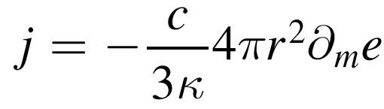
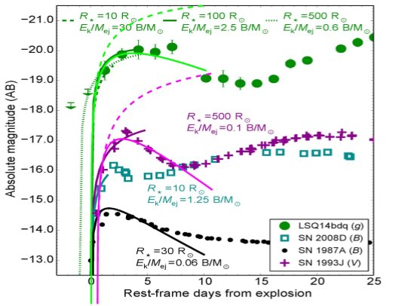

Equations for Physics Based Approach
j = Energy Flux
c = speed of light
Κ = Absorption Coefficient
r = radius
m = mass enclosed
4.)​
​
​
5.)
Waxman SN Light Interpolation 2017
p = Radiation Pressure
e = Energy Density​
We have performed trial runs to model the light curve using this physical model and found promising results, using a peak of the
Pictured to the right is a set of interpolations made as a reasoning for why the physics-based model is more useful produced in a paper written in the paper Sapir, Waxman et al (2017)

Slide 11
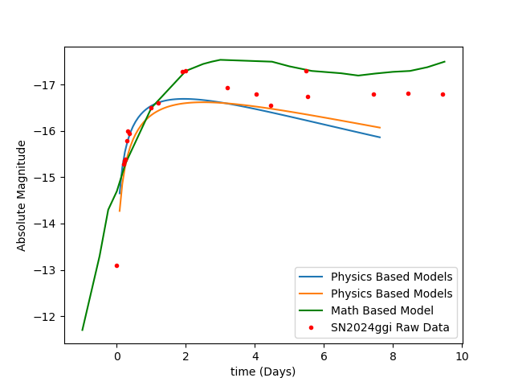
Physics and Math Based Models Comparison

Slide 12
Next Steps
Process all the candidates in the O4
Produce a method paper to characterize the performance of the quartic based model CCSNe from 2010-2024
Compare physics-based model and quartic-based model for accuracy by varying parameters and CCSNe candidates used

Slide 13

Questions?
Katelynn Wall Wallk@my.erau.edu
Jake Markovsky Markovsj@my.erau.edu
Embry Riddle Aeronautical University

Slide 14
Bibliography
Arnett, D. (1980). Analytic solutions for light curves of supernovae of type II. The Astrophysical Journal. 237. 541-549. 10.1086/157898.
Arnett, W. D., & Fu, A. (1989), The late behavior of supernova 1987A. I. the light curve. The Astrophysical Journal. 340. 396. 10.1086/167402
Couch, S. M., Warren, M. L., & O’Connor, E. P. 2020,ApJ, 890, 127
Couch, S. M., Wheeler, J. C., & Milosavljevi´c, M.2009, ApJ, 696, 953
Kaufman, K., UCLA, CaRT. (2010) Using supernova observations in the electro-magnetic spectrum to guide LIGO searches for gravitational Waves. https://dcc.ligo.org/LIGO-T1000658
Nagy, A., Ordasi, A., Vink´o, J., Wheeler, J.C. (2014). A semi-analytical lightcurve model and its application to type IIP supernovae. Astronomy & Astrophysics. 571. 10.1051/0004-6361/201424237.
Nakar, Ehud & Sari, Re’Em. (2010). Early supernovae light-curves following the shockbreakout. Astrophysical Journal. 725. 10.1088/0004637X/725/1/904.
Pejcha, Ondrej & Prieto, Jose. (2014). A Global Model of The Light Curves and Expansion Velocities of Type II-Plateau Supernovae. The Astrophysical Journal. 799. 10.1088/0004637X/799/2/215.
Rabinak, I., & Waxman, E. (2010). The Early UV/Optical Emission from Core-collapse Supernovae. Astrophysical Journal. 728. 10.1088/0004637X/728/1/63.
Sapir, N. & Waxman, E. (2016). UV/Optical Emission from the Expanding Envelopes of Type II Supernovae. The Astrophysical Journal. 838.10.3847/15384357/aa64df.
Szczepa´nczyk, M.J, Zheng, Y., Antelis, J.M., Benjamin, M., Bizouard, M.A.,Casallas-Lagos, A., Cerd´a-Dur´an, P., Davis, D., Gondek-Rosi´nska, D., Klimenko, S., Moreno, C., Obergaulinger, M., Powell, J., Ramirez, D., Ratto, B.,Richardson, C., Rijal, A., Stuver, A.L., Szewczyk, P., Vedovato, G., Zanolin, M.,Bartos, I., Bhaumik, S., Bulik, T., Drago, M., Font, J.A., De Colle, F., Garc´ıaBellido, J., Gayathri, V., Hughey, B., Mitselmakher, G., Mishra, T., Mukherjee,S., Nguyen, Q.L., Chan, M.L., Palma, I.D., Piotrzkowski, B.J., Singh, N. (2023).An Optically Targeted Search for Gravitational Waves emitted by Core-CollapseSupernovae during the Third Observing Run of Advanced LIGO and AdvancedVirgo. The Astrophysical Journal. https://arxiv.org/abs/2305.16146
Vallely, P.J., Kochanek, C.S., Stanek, K.Z., Fausnaugh, M., & Shappee, B.J.(2020). High-cadence, early-time observations of core-collapse supernovae from the TESS prime mission. Monthly Notices of the Royal Astronomical Society.500. 5639-5656. 10.1093/mnras/staa3675.

